Slide 1
NEURAL NETWORKS
Thesis presentation, Yfantidis Dimitrios, AEM: 3938, 7^{ο} Semester
Implementation: python v.3.10.7 in a Jupyter Notebook environment
Databases: CIFAR10 (1^{η} Interim Work, 1^{η} Work, 2^{η} Work), MNIST digits (3^{η} Work).
Data source: downloaded via the keras library (keras.Datasets), except for the 1^{ης} Interim Task where they were installed locally on the hard disk and read via the pickle library according to the instructions of the official CIFAR10 website.

Slide 2
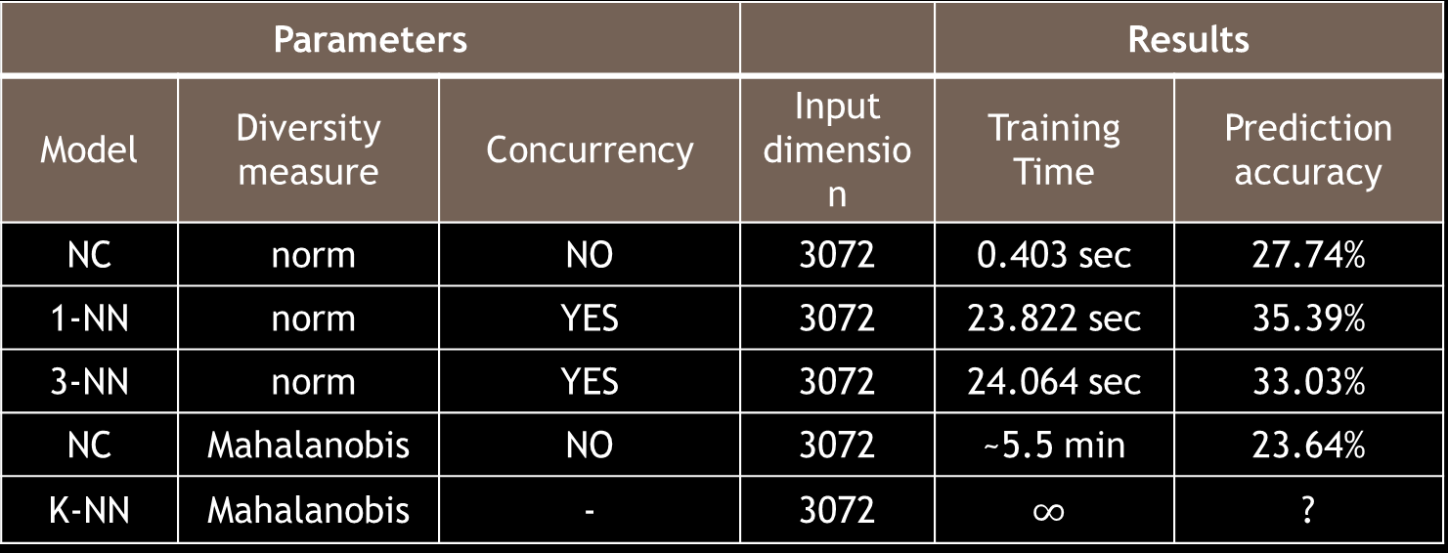
1^{η} Interim Task Categorizers k nearest neighbours (K-NN) and nearest centre (NC)
Loading CIFAR10 and visualizing its data with matplotlib.
Use of KNearestNeighbors and NearestCentroid of sklearn.
Statistics (training time, prediction accuracy, data dimension):
Parameters |  |  |  | Results
Model | Diversity measure | Concurrency | Input dimension | Training Time | Prediction accuracy
NC | norm | NO | 3072 | 0.403 sec | 27.74%
1-NN | norm | YES | 3072 | 23.822 sec | 35.39%
3-NN | norm | YES | 3072 | 24.064 sec | 33.03%
NC | Mahalanobis | NO | 3072 | ~5.5 min | 23.64%
K-NN | Mahalanobis | - | 3072 | $$∞$$ | ?

Slide 3

1^{η} Interim Task Categorizers k nearest neighbours (K-NN) and nearest centre (NC)
Input data dimensionality minimization application
Initially grayscale (3072 → 1024), then PCA (3072 → n) for n = 30, 50, 100, 300, 500
For dissimilarity measure norm and identity time in 1-NN and 3-NN:
 | NC |  | 1-NN |  | 3-NN
Input dimension | Accuracy | Time | Accuracy | Time | Accuracy | Time
Gray →1024 | 24.12% | 0.215 sec | 30.18% | 4.833 sec | 27.93% | 5.005 sec
PCA → 30 | 27.62% | 0.019 sec | 38.93% | 0.645 sec | 38.34% | 0.651 sec
PCA → 50 | 27.59% | 0.025 sec | 39.16% | 0.654 sec | 37.68% | 0.796 sec
PCA → 100 | 27.66% | 0.035 sec | 38.61% | 0.866 sec | 36.77% | 0.911 sec
PCA → 300 | 27.73% | 0.075 sec | 36.90% | 1.637 sec | 34.49% | 1.750 sec
PCA → 500 | 27.74% | 0.122 sec | 36.30% | 2.380 sec | 33.71% | 2.379 sec

Slide 4
1^{η} Work Multilayer Perceptron Neural Network
Implemented using NumPy: FullyConnectedClassifier class exclusively in the NeuralNetwork.py script.
Normalize values from [0, 255] to [0, 1].
Dimensional minimization with PCA.
Cost minimization using Stochastic Epiclinic Process.
Input neurons = Input sample dimension
Output neurons = 10
Sigmoidal activation function in all hidden neurons of all hidden layers.
Cost function: first instantaneous squared error (ISE), then categorical cross entropy (CCE).
The parameters and statistics/results are detailed below ...

Slide 5
1^{η} Work Multilayer Perceptron Neural Network
Dimension Enter | #Neurone/ Hidden layer | Output activation | Learning rate | Cost function | #Decisions | Training Time | Prediction accuracy
128 | (128, 64) | sigmoid | 0.001 | ISE | 1000 | 3.15 hrs | 34.90%
128 | (128, 64) | softmax | 0.002 | ISE | 20 | 4.50 min | 28.98%
256 | (128, 64) | softmax | 0.002 | ISE | 253 | 1.00 hrs | 36.13%
256 | (256, 128, 64) | softmax | 0.0005 | CCE | 364 | 3.31 hrs | 31.33%
64 | (128, 64) | softmax | 0.001 | CCE | 345 | 40.0 min | 37.87%
Class | airplane | automotive | bird | cat | deer | dog | frog | horse | ship | truck
Accuracy | 55.6% | 37.6% | 24.6% | 1.3% | 31.2% | 37.7% | 58.4% | 34.2% | 49.3% | 52.1%

Slide 6
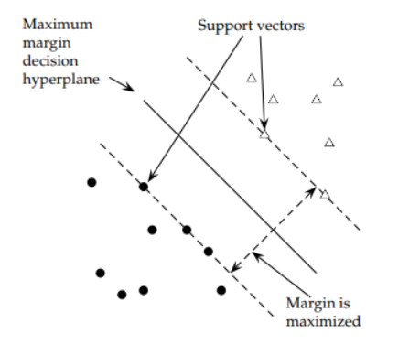
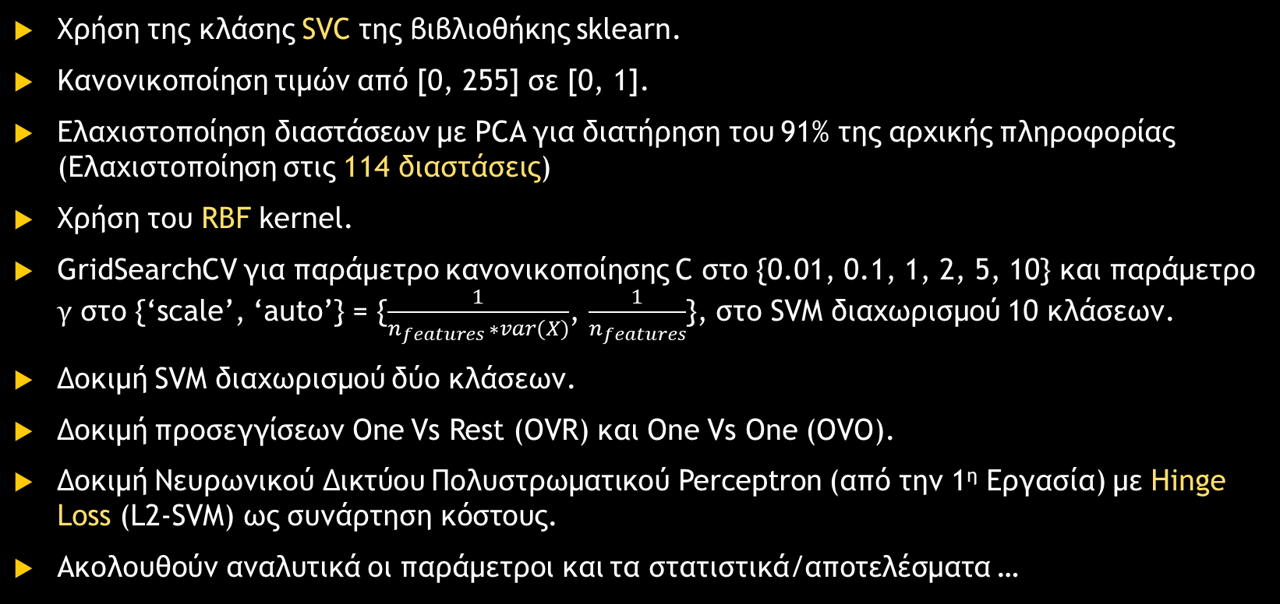
2^{η} Work Support Vector Machine
Use the SVC class of the sklearn library.
Normalize values from [0, 255] to [0, 1].
Dimensional minimization with PCA to preserve 91% of the original information (Minimization to 114 dimensions)
Use of the RBF kernel.
GridSearchCV for normalization parameter C to {0.01, 0.1, 1, 2, 5, 10} and parameter to {'scale', 'auto'} = { , }, in the SVM separation of 10 classes.
Testing SVM separation of two classes.
Testing One Vs Rest (OVR) and One Vs One (OVO) approaches.
Testing Multilayer Perceptron Neural Network (from 1^{η} Work) with Hinge Loss (L2-SVM) as a cost function.
The parameters and statistics/results are detailed below ...

Slide 7
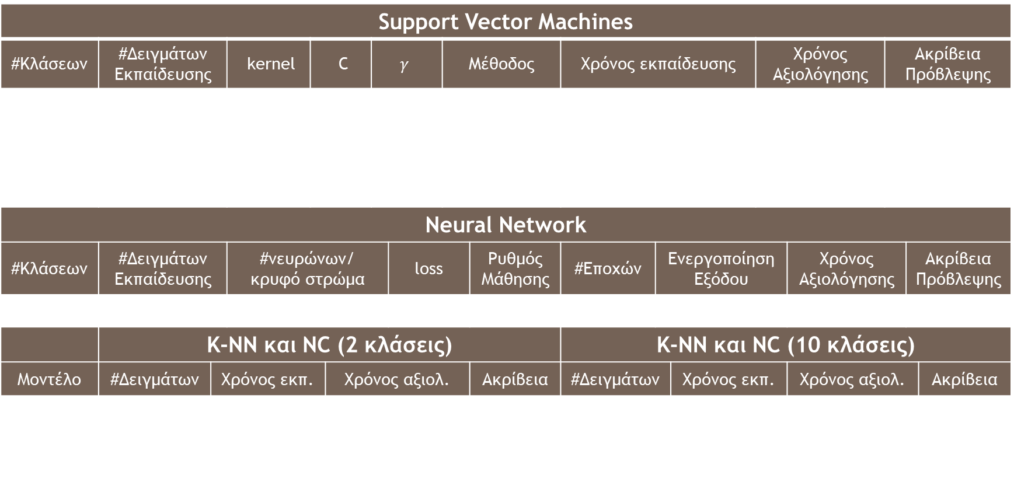
2^{η} Work Support Vector Machine
Support Vector Machines
#Classes | #Samples of Education |  | kernel | C |  | $$γ$$ |  | Method |  | Training time |  |  | Time Evaluation Time |  | Prediction accuracy
10 | 50000 |  | RBF | 5 |  | car |  | OvR |  | 57 min (GridSearch) |  |  | 43.7 sec |  | 56.53%
2 | 50000 |  | RBF | 1 |  | scale |  | - |  | 3 sec |  |  | 0.5 sec |  | 92.55%
10 | 50000 |  | RBF | 5 |  | car |  | OvO |  | 7 min |  |  | 1 min |  | 56.35%
10 | 200000 |  | RBF | 5 |  | car |  | OvR |  | $$∞$$ |  |  | $$∞$$ |  | ?
neural network
#Classes | #Samples of Education |  | #neuron/hidden layer |  |  | loss | loss | Learning rate | Learning rate | #Decisions | Output Activation |  |  | Time Evaluation Time |  | Prediction accuracy
10 | 50000 |  | (114, 128, 64, 10) |  |  |  | L2-SVM |  | 0.002 | 62 | ReLU |  |  | 3.5 min |  | 35.8%
 | K-NN and NC (2 classes) |  |  |  |  |  |  |  |  | K-NN and NC (10 classes)
Model | #Samples | Exposure time. | Time merit. | Time merit. | Time merit. |  | Accuracy | Accuracy | Accuracy | #Samples | Exposure time. | Exposure time. | Exposure time. | Time merit. |  | Accuracy | Accuracy
1-NN | 50000 | < 0.01 sec |  | 0.06 sec | 0.06 sec |  |  | 82.45% | 82.45% | 50000 |  | 0.01 sec |  | 0.89 sec |  | 38.21% | 38.21%
3-NN | 50000 | < 0.01 sec |  | 0.05 sec | 0.05 sec |  |  | 84.70% | 84.70% | 50000 |  | 0.01 sec |  | 0.88 sec |  | 36.33% | 36.33%
NC | 50000 | < 0.01 sec |  | < 0.01 sec | < 0.01 sec |  |  | 76.80% | 76.80% | 50000 |  | 0.02 sec |  | 0.01 sec |  | 27.67% | 27.67%

Slide 8
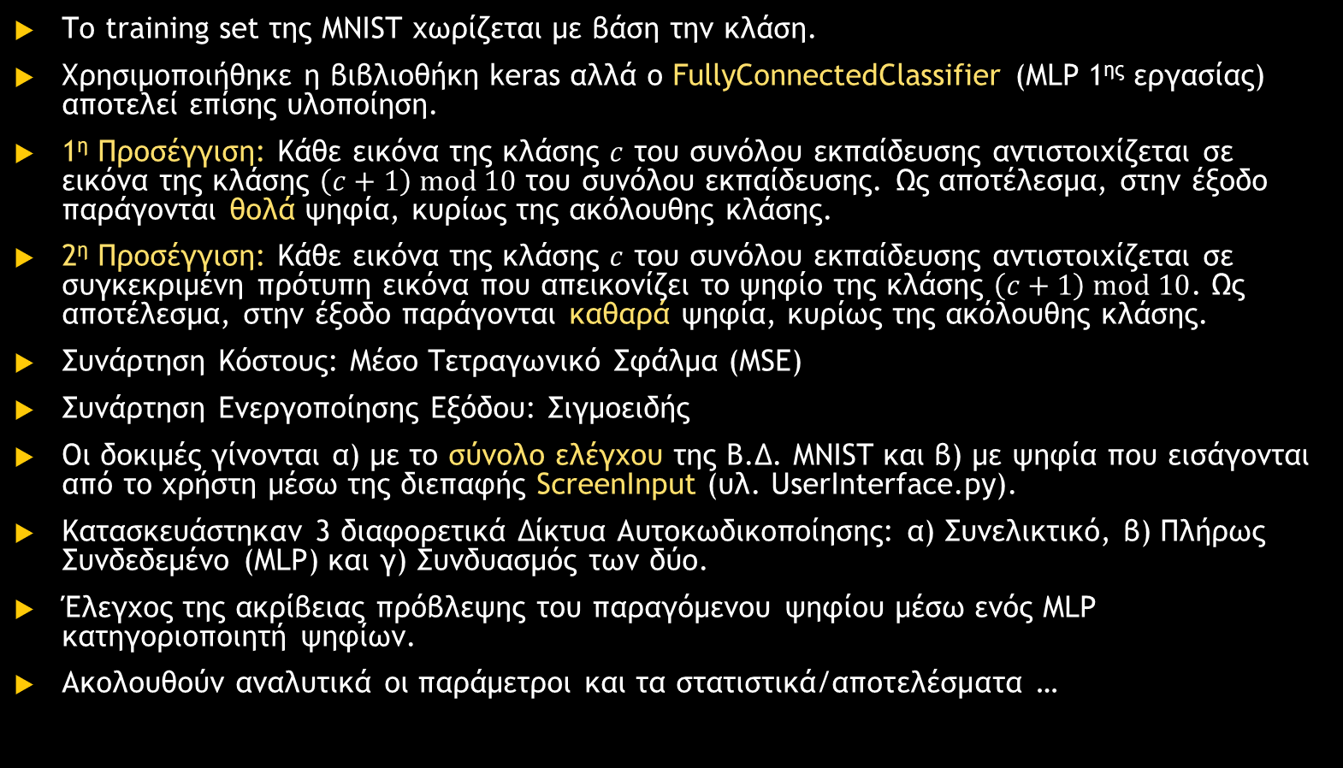
3^{η} Work Autoencoder data compression and reconstruction
The MNIST training set is divided by class.
The keras library was used but FullyConnectedClassifier (MLP 1^{ης} working) is also an implementation.
1^{η} Approach: Each image of the class of the training set is mapped to an image of the class of the training set. As a result, blurred digits are produced in the output, mainly of the following class.
2^{η} Approach: Each image of the class of the training set is mapped to a specific template image representing the digit of the class. As a result, pure digits are produced in the output, mainly of the following class.
Cost function: Mean Square Error (MSE)
Output Activation Function: Sigmoidal
The tests are performed a) with the MNIST B.D. control set and b) with user-entered digits via the ScreenInput interface (yl. UserInterface.py).
3 different Self-Coding Networks were constructed: a) Convolutional, b) Fully Linked (MLP) and c) Combination of the two.
Checking the prediction accuracy of the generated digit through an MLP digit classifier.
The parameters and statistics/results are detailed below ...

Slide 9
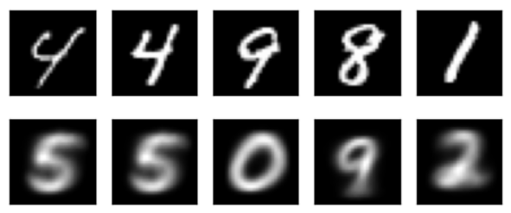
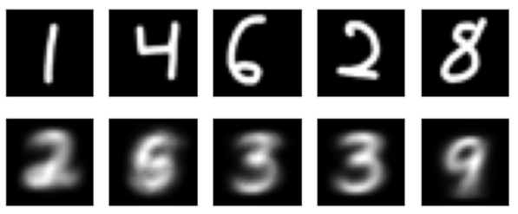
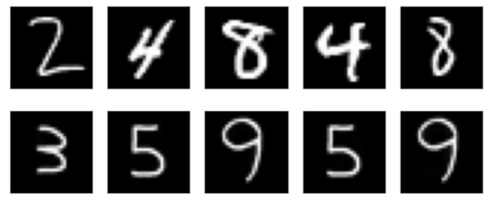
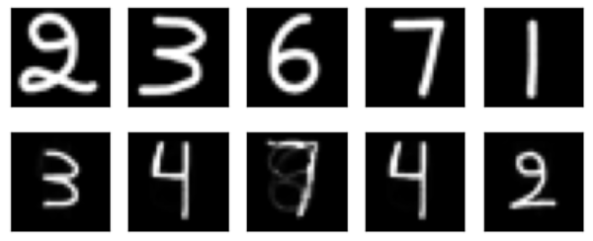
3^{η} Work Autoencoder data compression and reconstruction
Results 1^{ης} Approach (Test Set: left, User Login: right)
Results 2^{ης} Approach (Test Set: left, User Login: right)
Possibly the different "touches" of the UserInterface are responsible.

Slide 10
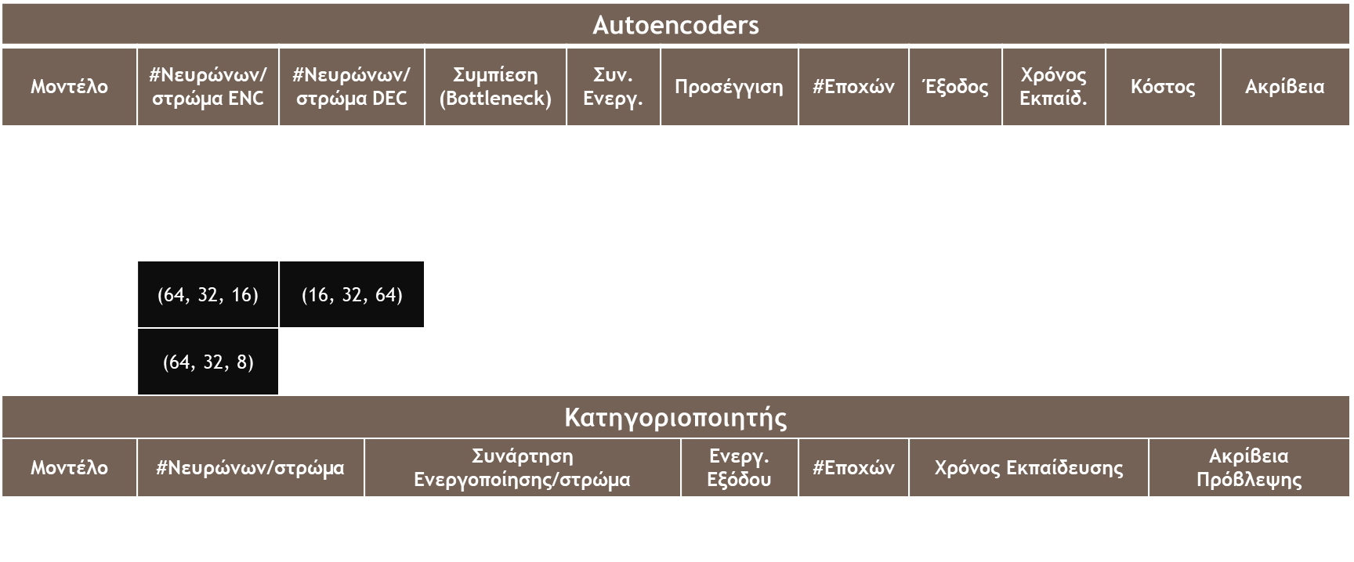
3^{η} Work Autoencoder data compression and reconstruction
* Black cells refer to #filters/layer for constellation architectures
Autoencoders
Model | #Neuron/layer ENC | #Neuron/layer DEC |  | Compression (Bottleneck) | Plus. Active. | Approach |  | #Decisions | Exit | Time Education. | Cost |  | Accuracy
MLP Autoencoder | (128, 64, 32) | (32, 64, 128) |  | [0, 1]⁸ | ReLU, tanh | 1 ^{η} |  | 5 | blurry | 22.7 sec | 0.0550 |  | 67.20%
MLP Autoencoder | (128, 64, 32) | (32, 64, 128) |  | [0, 1]⁸ | ReLU, tanh | 2 ^{η} |  | 5 | net | 21.9 sec | 0.0015 |  | 77.62%
Conv. autoencoder | (64, 32, 16) | (16, 32, 64) |  | $$𝒯_{4, 4, 16}^{[0, 1]}$$ | sigmoid | 2 ^{η} |  | 10 | net | 15.8 min | 0.0037 |  | 74.63%
Mixed Autoencoder | (64, 32, 8) | (256, 512, 1024) |  | $$𝒯_{4, 4, 8}^{[0, 1]}$$ | ReLU, sigmoid | 2 ^{η} |  | 10 | net | 7.3 min | 0.0017 |  | 76.25%
Categorizer
Model | #Neuron/layer | Plus. Active. | Activation function/layer | Active Output | Active Output | Active Output | Active Output | #Decisions | Training Time |  |  | Prediction accuracy
MLP Classifier | (256, 128, 64, 32) |  | (ReLU, ReLU, sigmoid, sigmoid) |  |  | softmax | softmax | 5 | 22.5 sec |  |  | 97.76%

Slide 11
Conclusions and Comments
Statistical, mathematical methods such as K Nearest Neighbours and Nearest Class Centre are, in general, too simplistic for analysing abstract data such as images. However, they perform well in the CIFAR10 B.D. (KNN: ~38%, NC: ~27%).
Better performance is observed from SVMs (~55%) that also use mathematical methods, but of a more upstream philosophy (optimization, kernel trick, Lagrange multipliers).
Transition from mathematics to biology: A convolutional neural network can achieve even better than 55% accuracy. However, the Neural Network implemented is MLP while being a personal creation and not ready-made from a well-known library. It achieved ~38% prediction accuracy (From ready-made NN: >80%).
During training the prediction accuracy of the models increased continuously at the end of each season, proving that the logic was implemented correctly (FullyConnectedClassifier and keras tools).
Finally, the Autocoders performed well regardless of their architecture but inversely related to the size of the latent space. Also, testing performed better when done with the MNIST test dataset than with user input digits.

